Slide 1
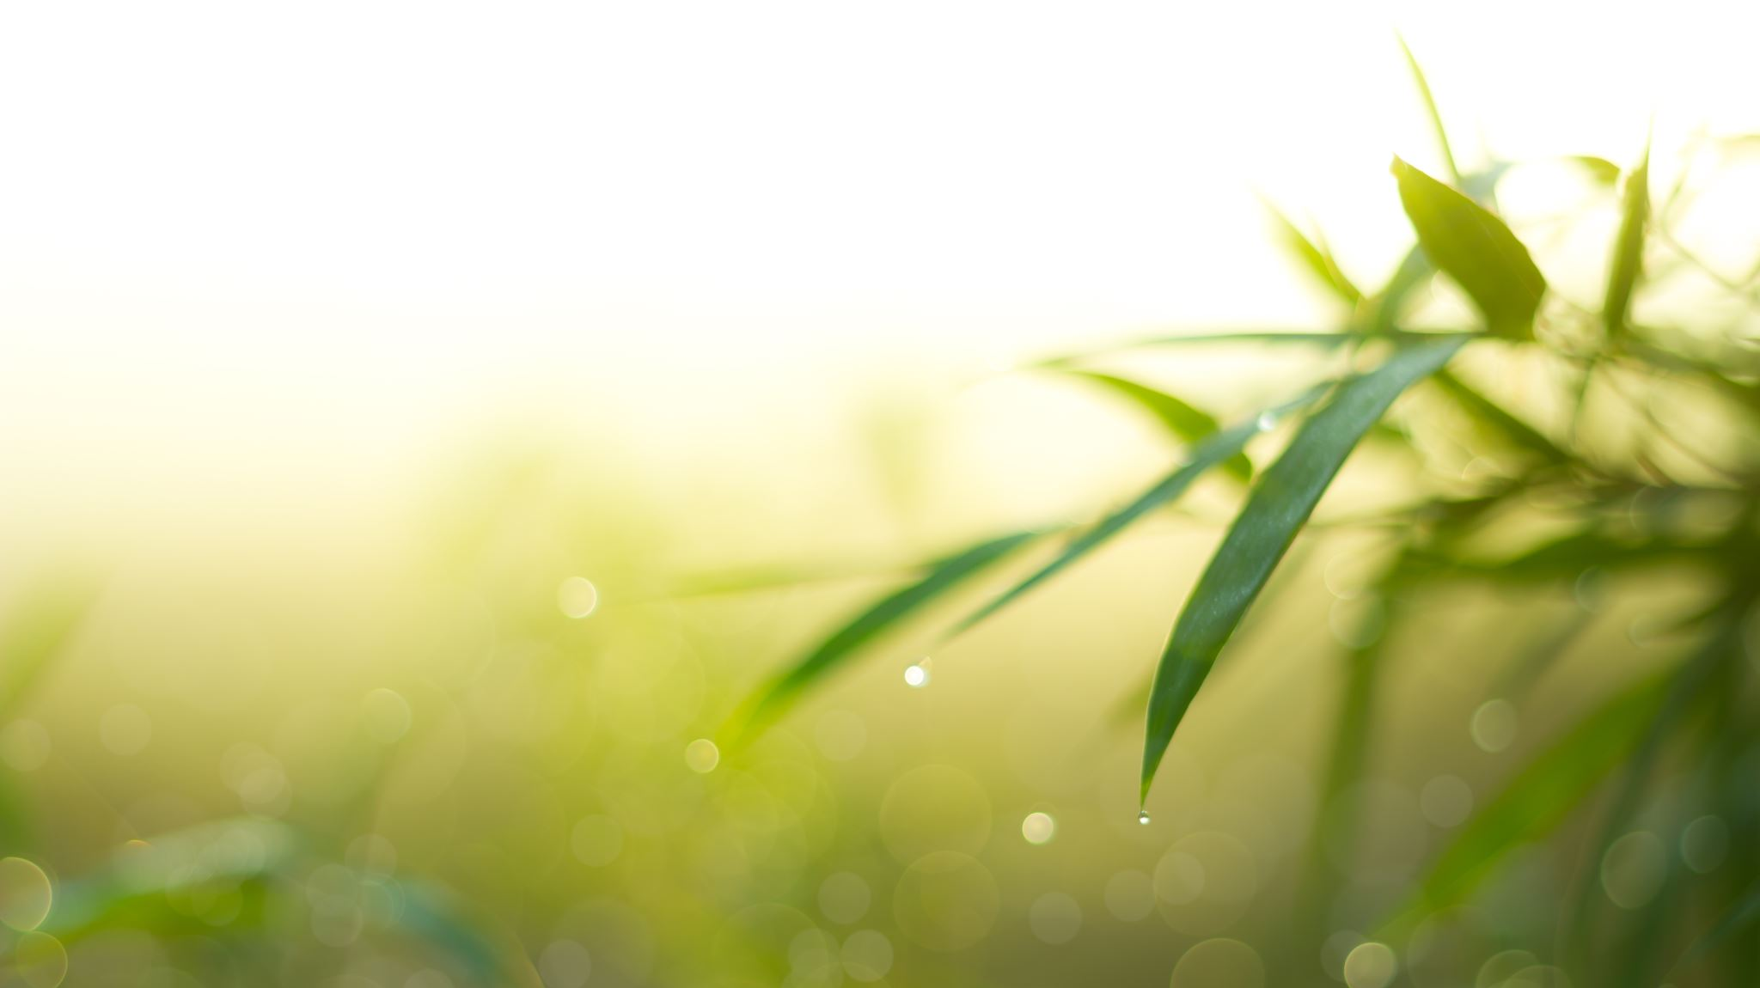
Artificial Plants
www.funkyyukka.co.uk 08005874672

Slide 2
Plants, Bushes & Ferns
www.funkyyukka.co.uk 08005874672

Slide 3
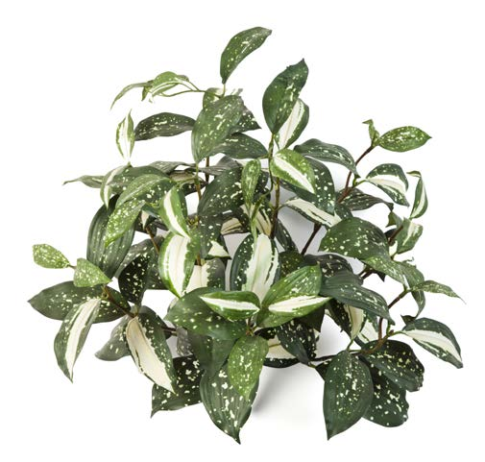
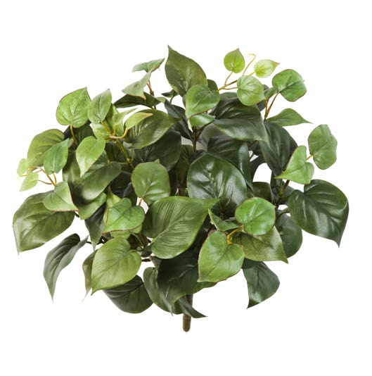
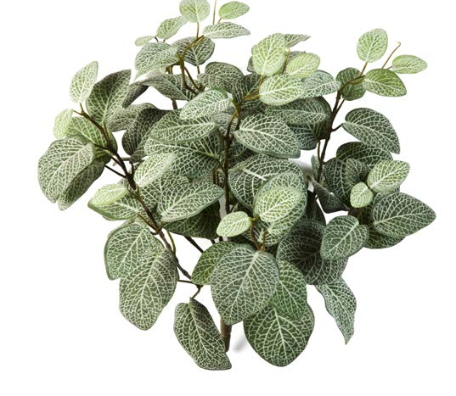
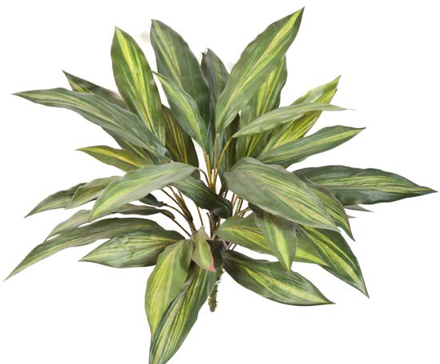
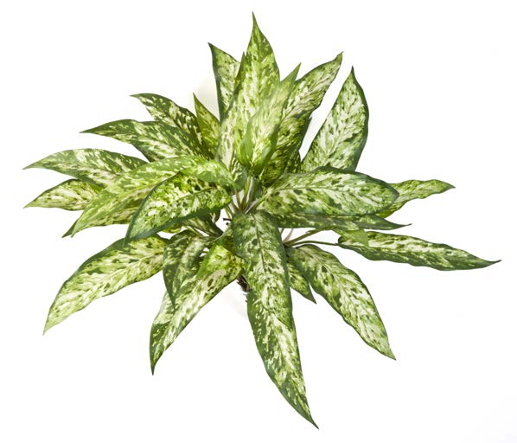
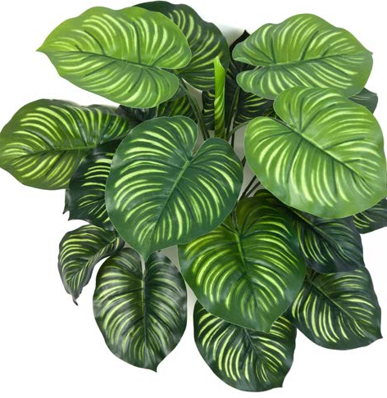
PHILO
PHI35
35cm
FITTONIA
FIT35
35cm
CORDYLINE
COR35
35cm
DRACAENA
DRA40
40cm
AGLAONEMA
AGL40
40cm
CALATHEA
CAL45
45cm

Slide 4
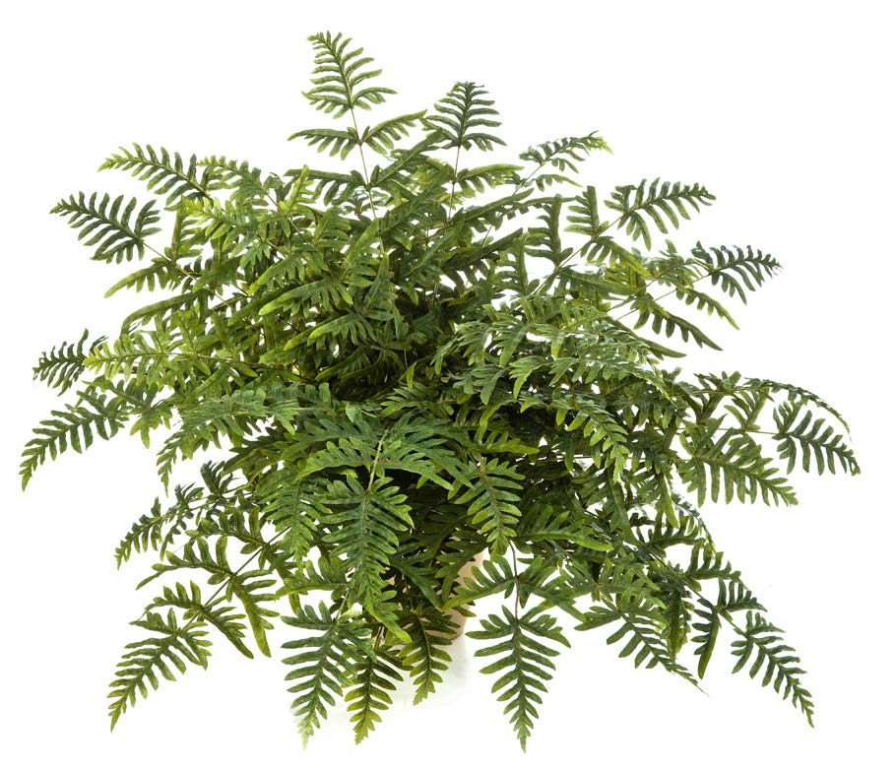
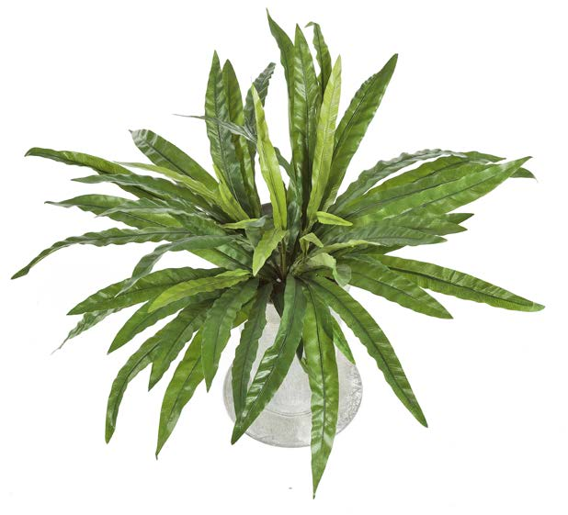
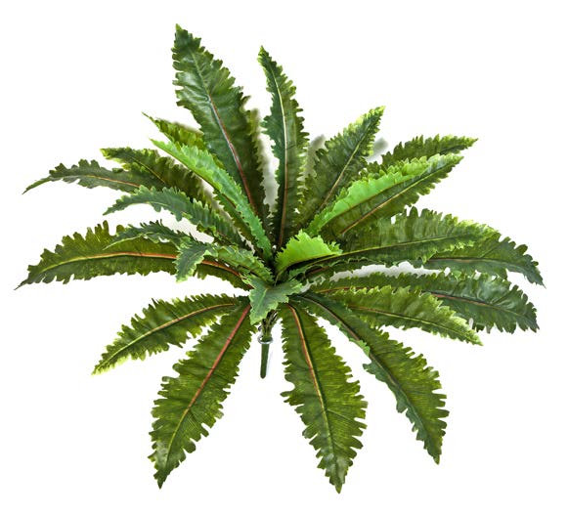
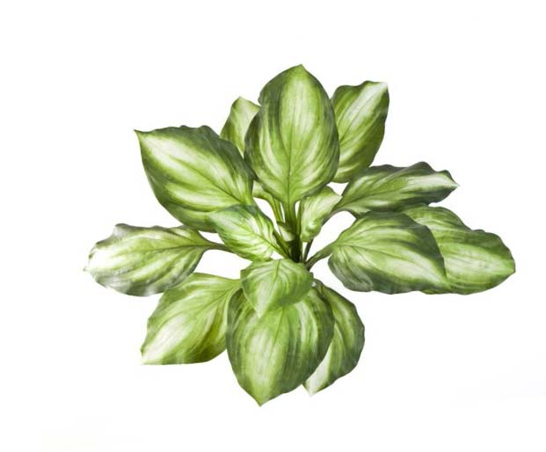
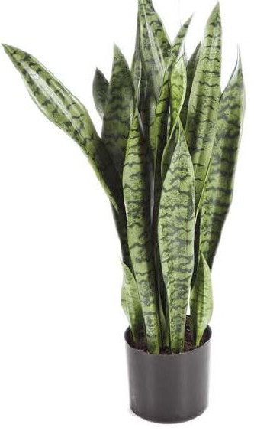
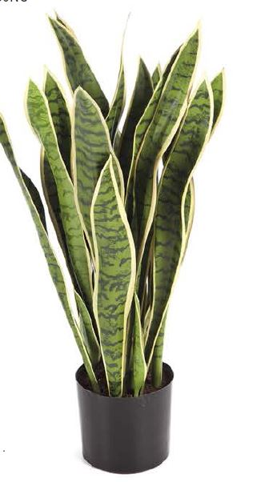
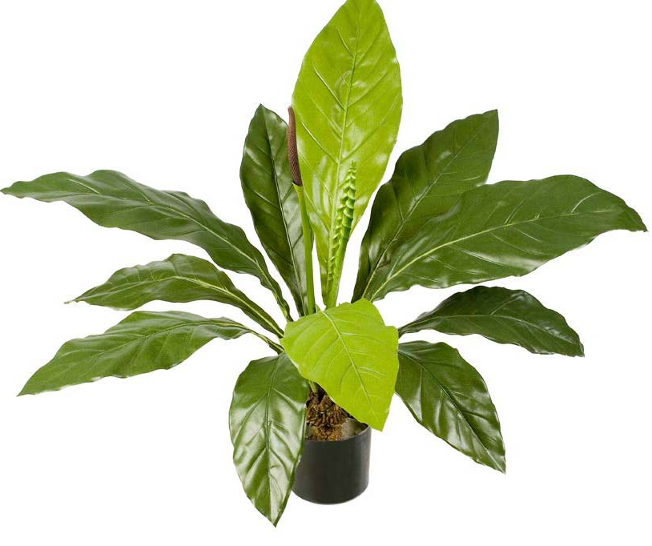
ATHYRIUM FERN
ATH90, 90cm
ASPLENIUM
ASP65, 65cm
MARGARINTUM FERN
MAR7, 70cm
HOSTA
HOS60
60cm
JUNGLE KING ANTHURIUM
JUK75, 75cm
SANSEVERIA GREEN
SANG80, 80cm
SANSEVERIA YELLOW
& GREEN
SANY80, 80cm

Slide 5
ATHYRIUM FERN
ATH90
90cm
ASPLENIUM
ASP65
65cm
MARGARINTUM FERN
MAR70
70cm
HOSTA
HOS60
60cm
JUNGLE KING ANTHURIUM
JUK75, 75cm
SANSEVERIA GREEN
SANG80, 80cm
SANSEVERIA YELLOW
& GREEN
SANY80 80cm

Slide 6
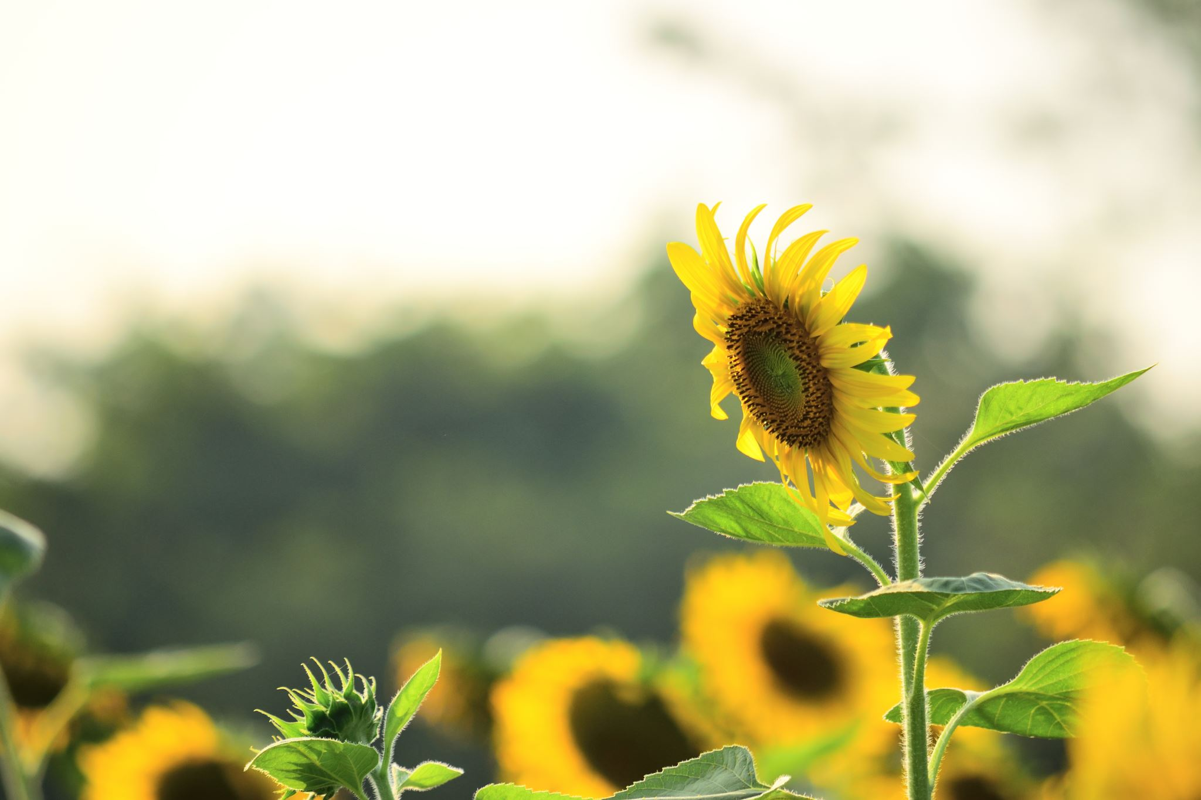
Flowering Plants
www.funkyyukka.co.uk 08005874672

Slide 7
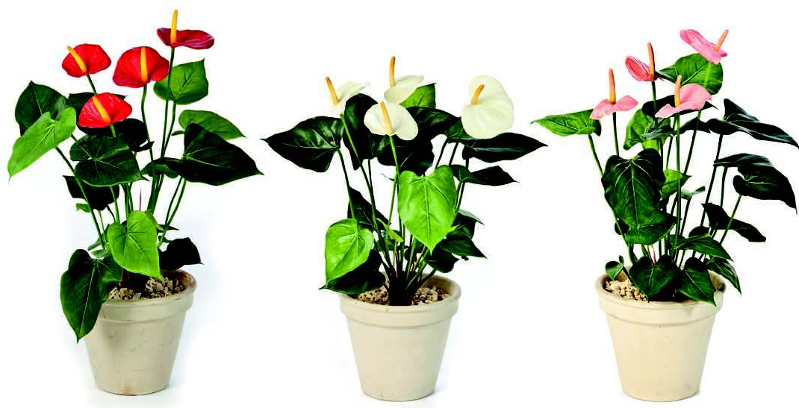
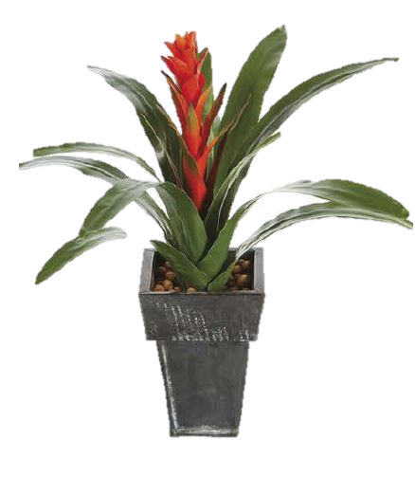
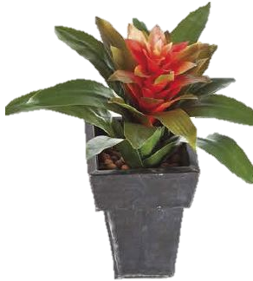
ANTHURIUM RED
ANR56
56cm
ANTHURIUM WHITE
ANW56
56cm
ANTHURIUM PINK
ANP56
56cm
BROMELIA
BRO32
32cm
GUZMANIA
GUZ47
47cm

Slide 8
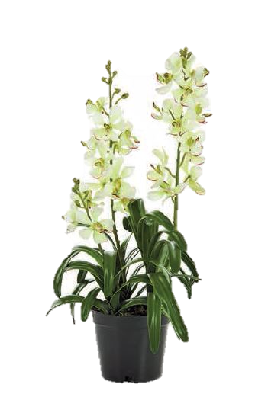
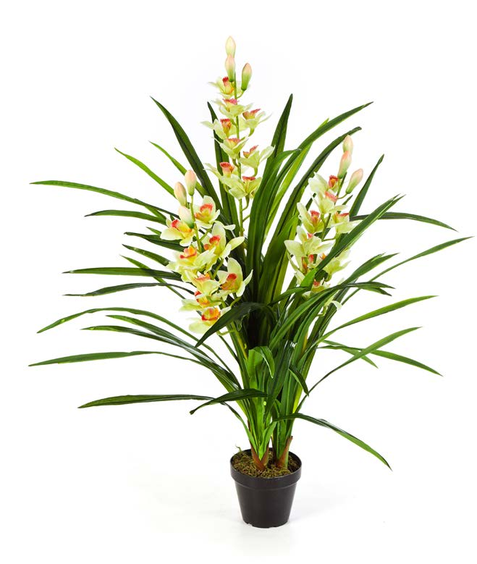
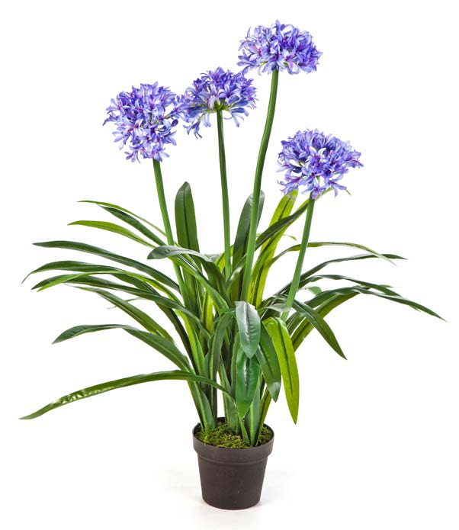
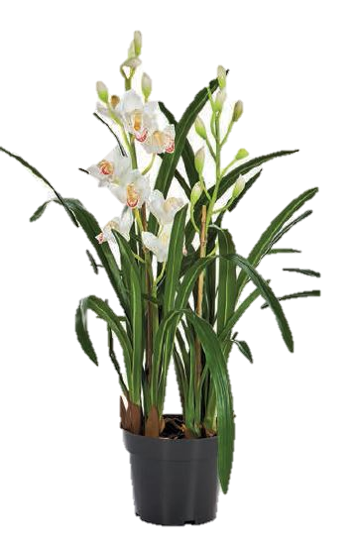
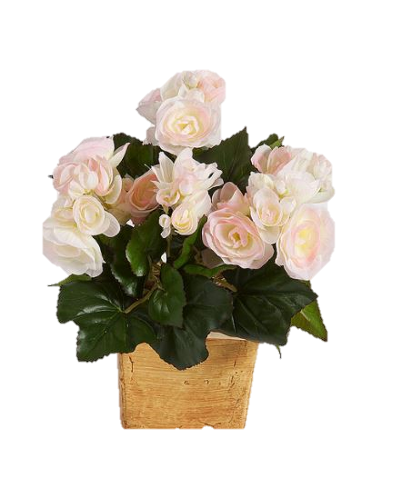
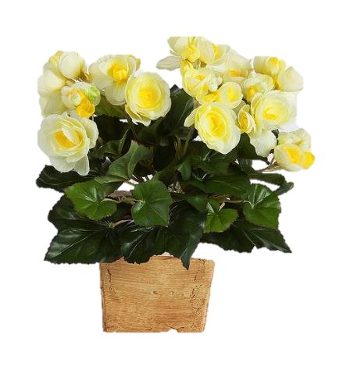
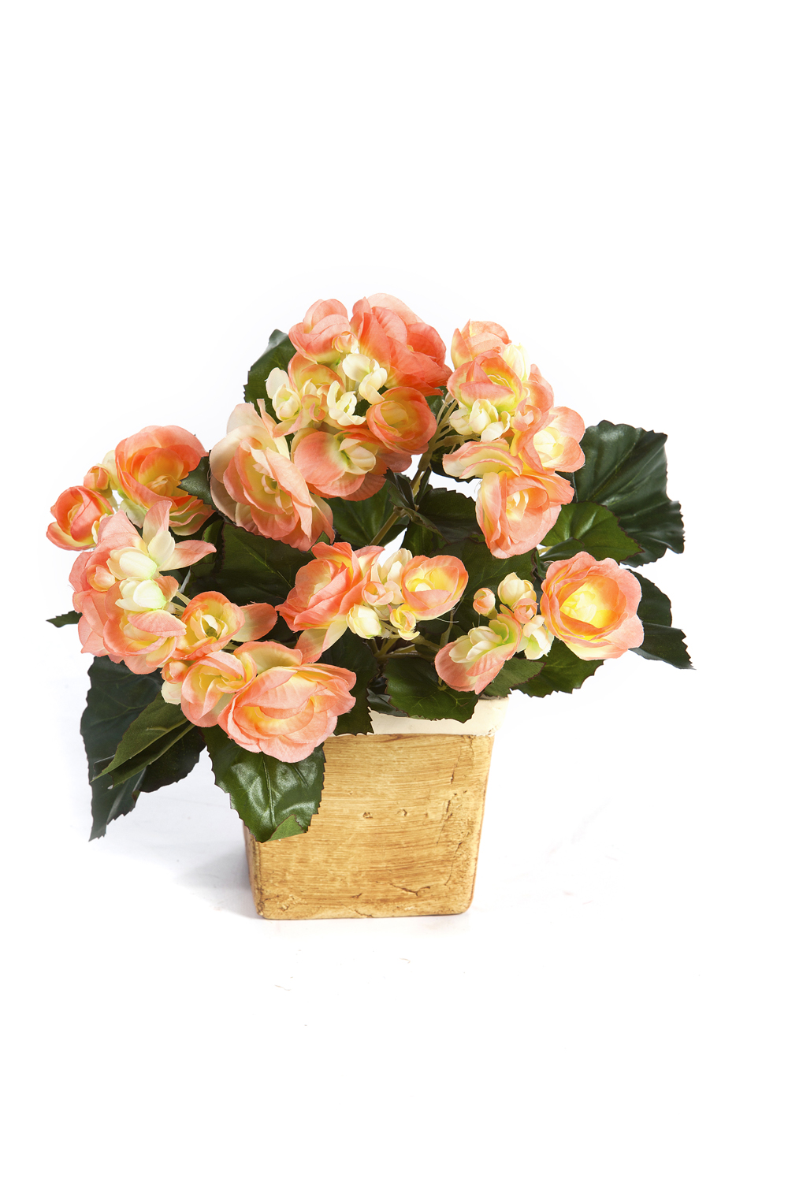
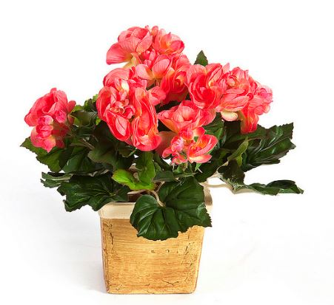
ATHYRIUM FERN
ATH90
90cm
AGAPANTHUS
AGA100
100Cm
VANDA ORCHID WHITE
VORW64
64cm
CYMBIDIUM WILD ORCHID WHITE
COW95 95cm
BEGONIA ORANGE
BEO20
20cm
BEGONIA PALE PINK
BEP20
20cm
BEGONIA CORAL
BEC20
20cm
BEGONIA YELLOW
BEY20
20cm

Slide 9
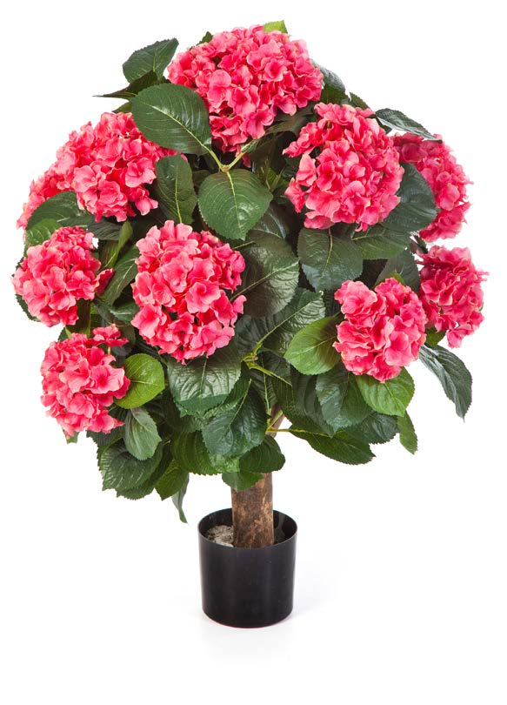
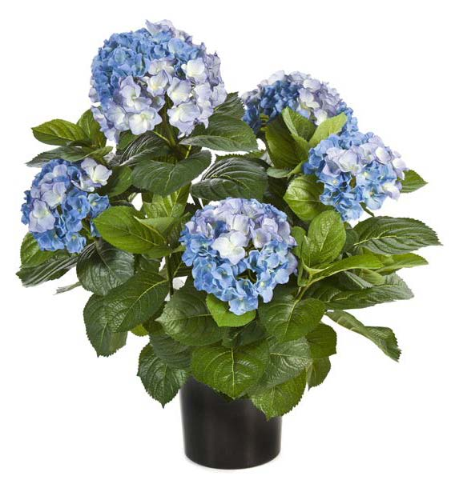
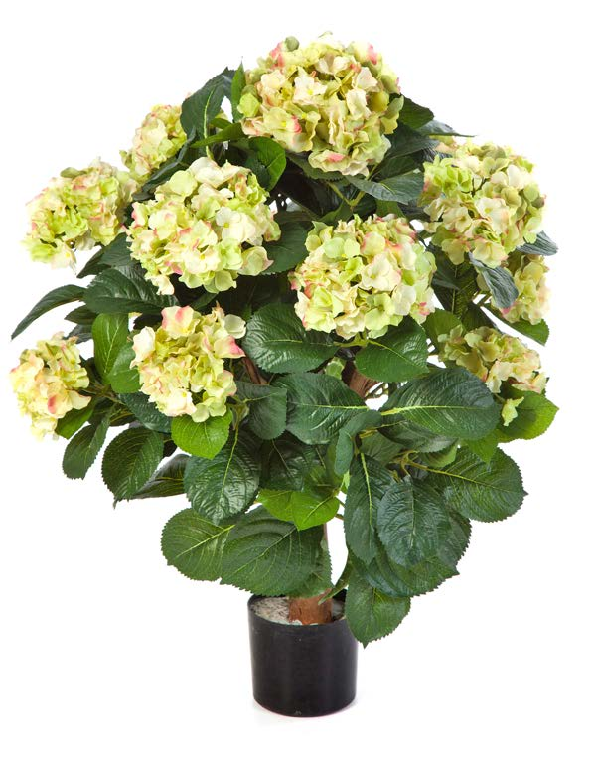
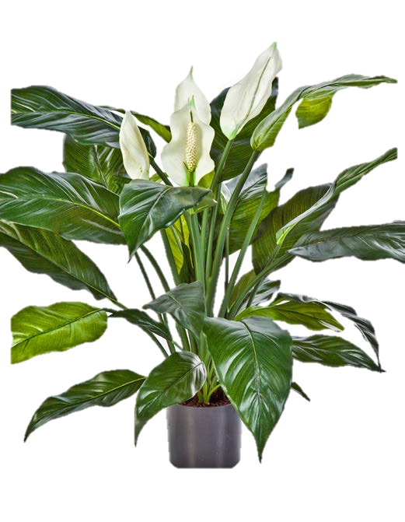
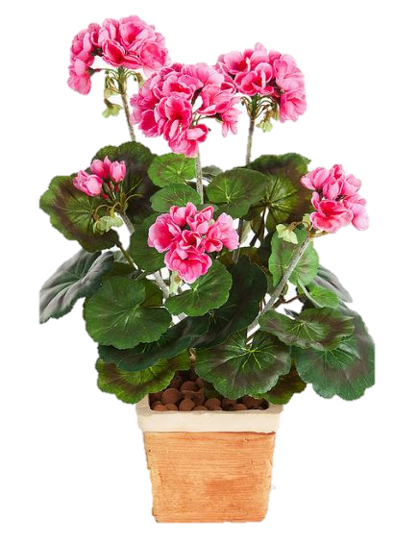
HYDRANGEA PINK
HYP62, 62cm
HYDRANGEA BLUE
HYB53, 53cm
HYDRANGEA YELLOW GREEN
HYY62, 62cm
SPATHIPHYLLUM
SPA75, 75cm
GERANIUM PINK
GEP20, 33cm
BEGONIA PALE PINK
BEP20, 20cm
BEGONIA CORAL
BEC20, 20cm
BEGONIA YELLOW
BEY20, 20cm

Slide 10
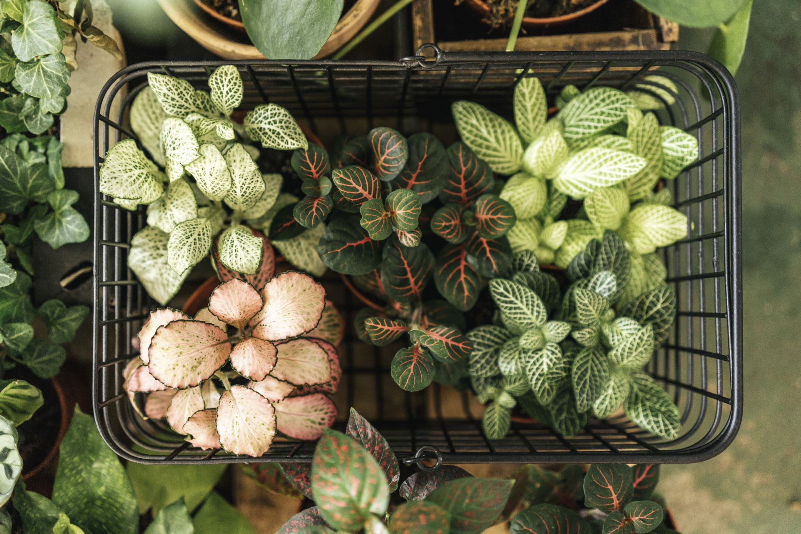
Hanging Plants
www.funkyyukka.co.uk 08005874672

Slide 11
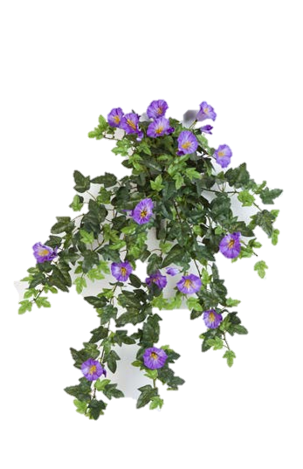
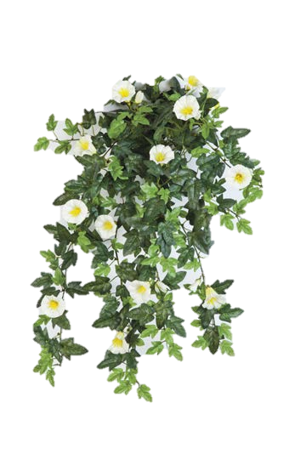
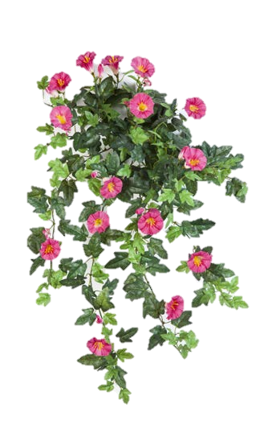
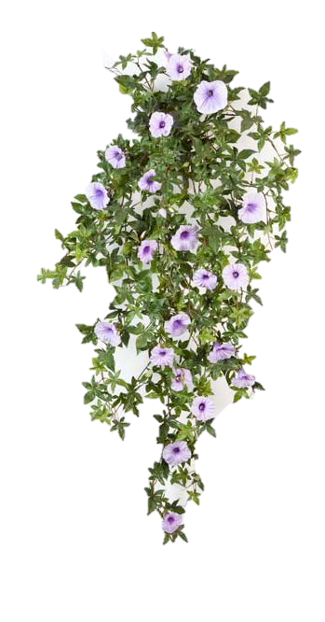
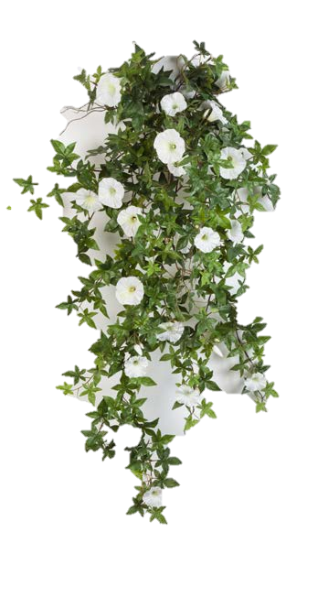
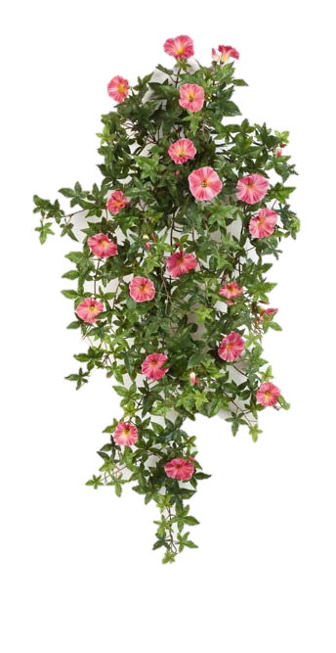
PETUNIA PINK
PPK60
60cm
PETUNIA PURPLE
PPU60
60cm
PETUNIA YELLOW
PYE60
60cm
MORNING GLORY PURPLE
MGP95
95cm
MORNING GLORY WHITE
MGP95
95cm
MORNING GLORY PINK
MGP95
95cm

Slide 12
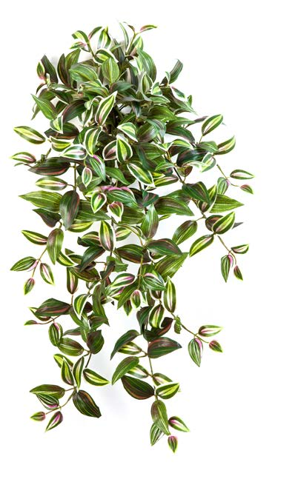
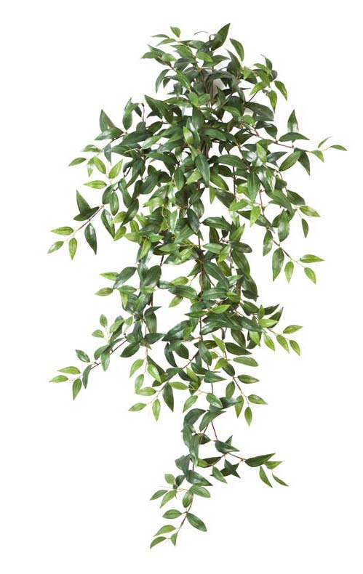
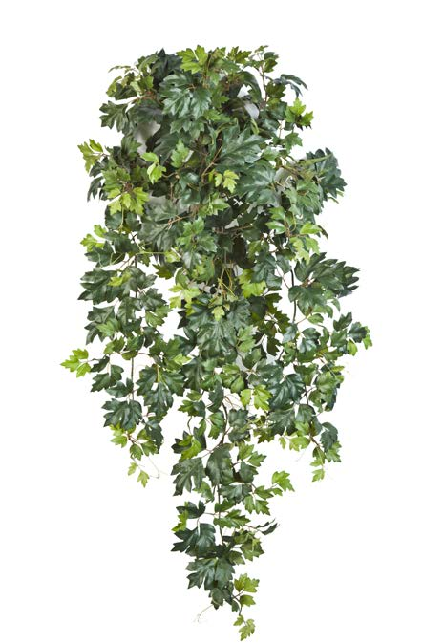
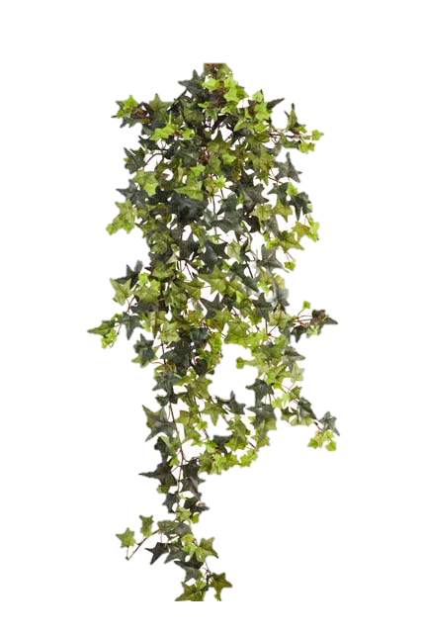
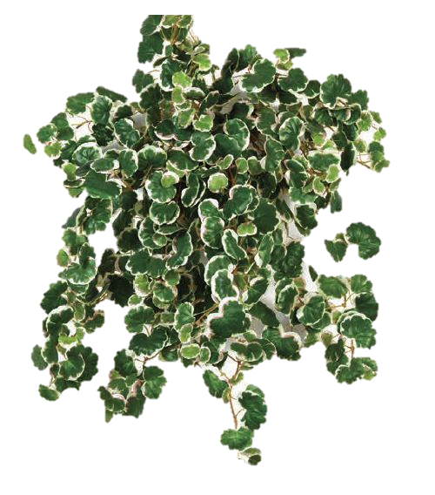
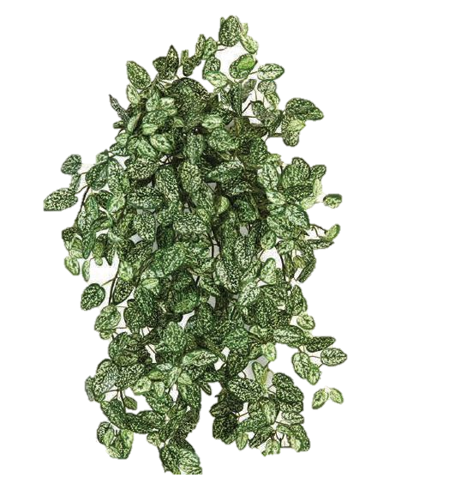
WANDERING JEW
WAJ70
70cm
TRADESCANTIA
TRS105
105cm
GRAPE IVY
GRI90
90cm
STAR IVY
STI80
80cm
MINI STRAWBERRY
MNS50
50cm
MINI HYPOESTES
MHY50
50cm

